Slide 1
The gym chain Model Fitness
to analyze customer profiles and come up with a customer retention strategy
Evgeniia Kozodeeva(Jane) Jiahuib Du(Mary)
Mark Krishnan Hung Lim(Hansen) Han Wang(Sher)

Slide 2

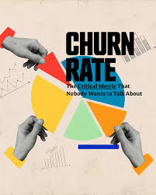
The gym chain One Fitness
Gym Chain One would like us to determine if a customer has disengaged?
Are there any factors that may contribute to a customer Continuing their membership or not?

Slide 3

Introduction
predict the probability of churn (for the upcoming month) for each customer
Draw up typical user portraits: select the most outstanding groups and describe their main features
Analyze the factors that impact churn most
Draw basic conclusions and develop recommendations on how to improve customer service:
Identify target groups
Suggest measures to cut churn
Describe any other patterns you see with respect to interaction with customers

Slide 4
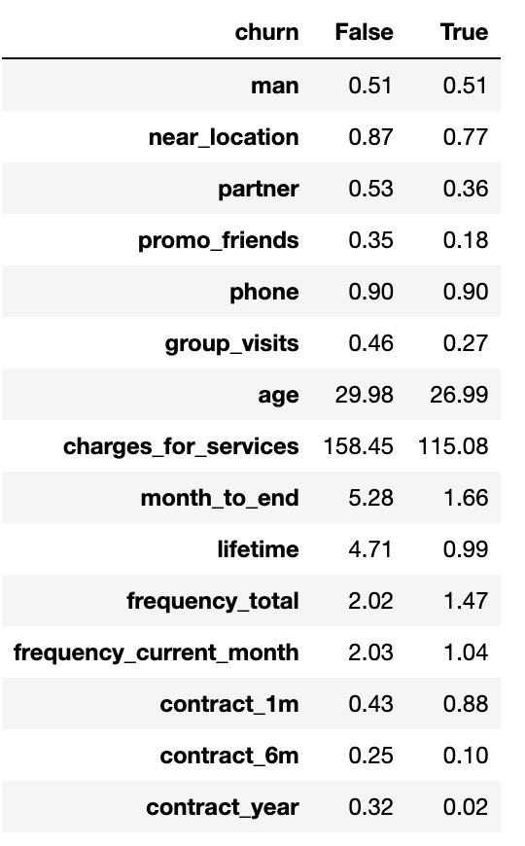
clients who left / clients who stay
Clients who live closer to the gym are more loyal customers.
Clients working in partner companies are more loyal customers.
Customers who came through the "bring a friend" promo are more loyal customers.
More customer churn among those who bought a gym membership for a shorter period.
Loyal clients are eager to attend group classes.
Loyal customers spend more money on additional services for the entire duration of the subscription. However, due to the fact that loyal customers go to the gym on average 5 times longer, and if we compare the costs of additional services per month, it turns out that customers who are inclined to stop exercising spend more money.
Not loyal customers, usually buy a gym membership for a small number of months. On average, they drop out when they still have 1.7 months left until the end of their contract, while loyal customers, on average, have 5 months until the end of their contract.
Loyal customers visit the gym more often.
Most clients who quit going to the gym did so in the first 2 months.

Slide 5
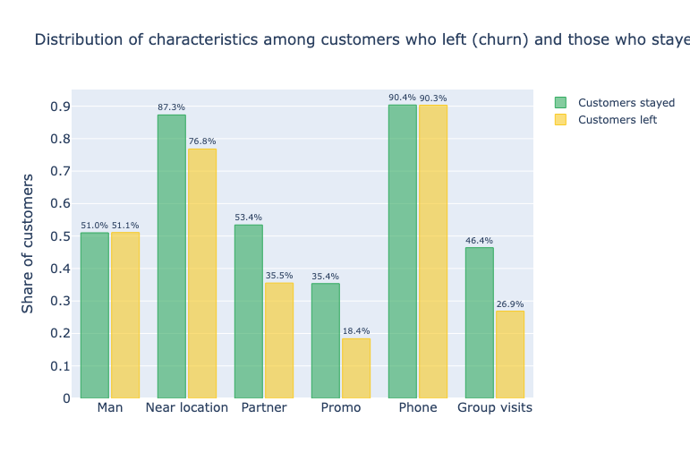
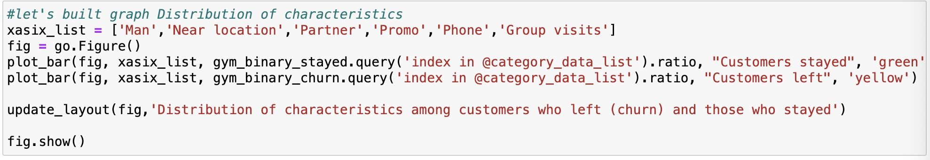
EDA – FEATURES 1
Clients who live closer to the gym are more loyal customers.
Clients working in partner companies are more loyal customers.
Customers who came through the "bring a friend" promo are more loyal customers.
Loyal clients are eager to attend group classes.
BY category data ANALYSIS VS CHURN RATES

Slide 6
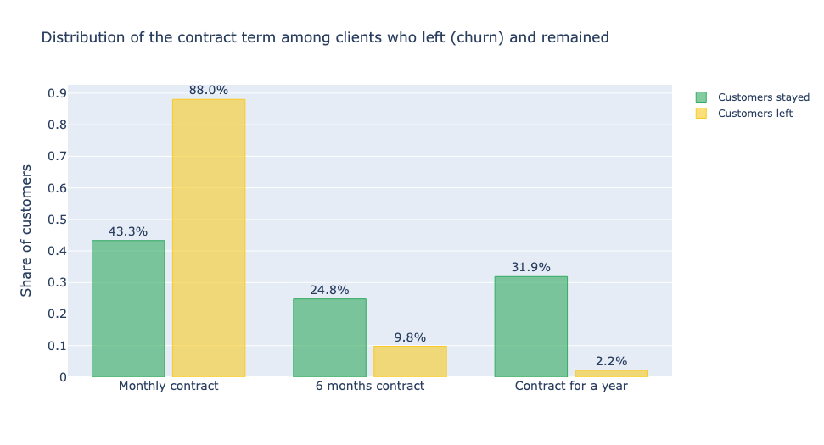
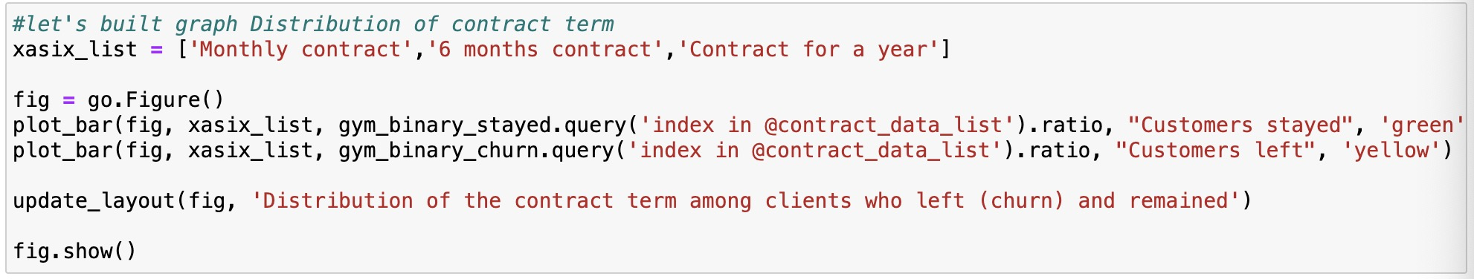
EDA – FEATURES 2
Non-loyal customers usually buy a gym membership for one month.
Clients who buy a one-year contract very rarely stop going to the gym.
BY CONTRACT TERMS ANALYSIS VS CHURN RATES

Slide 7
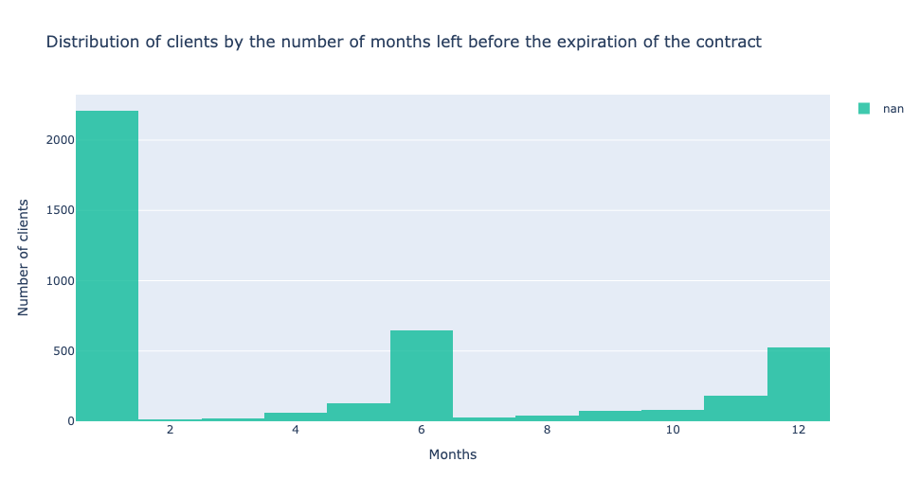
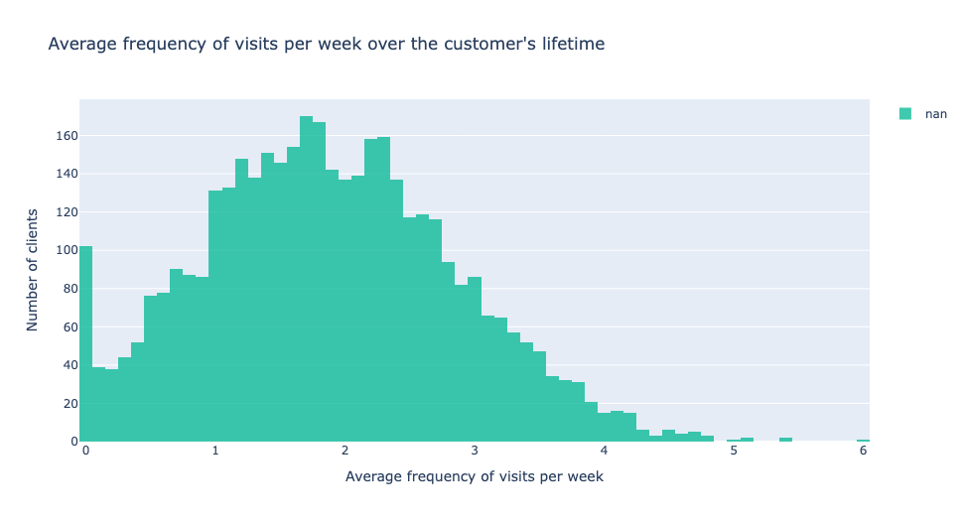
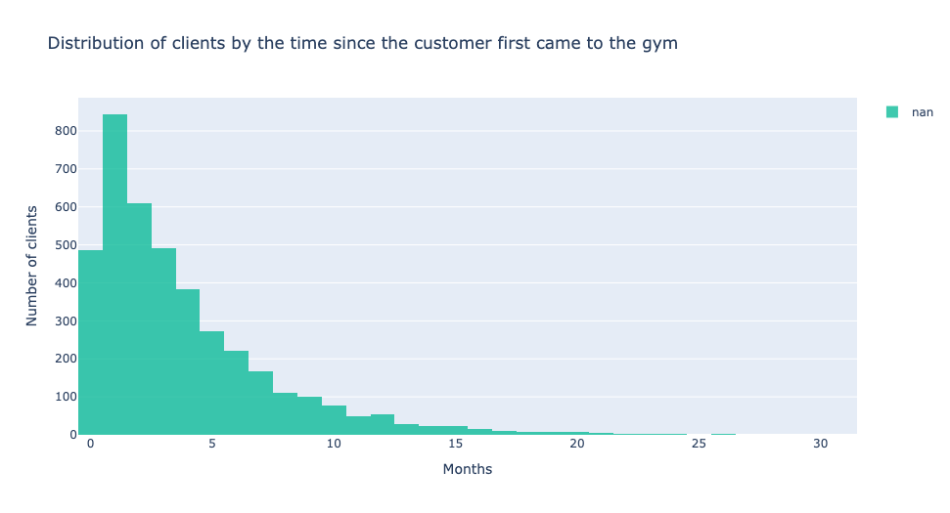
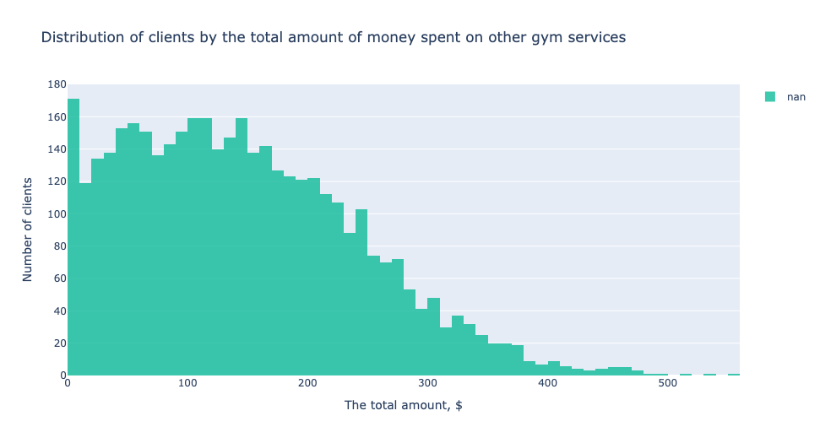
Eda – feature 3 - numeric dataset
CONTRACT:
Non-loyal customers usually buy a gym membership for one month. Clients who buy a one-year contract very rarely stop going to the gym.
Frequency: Loyal customers visit the gym more often.
COST: Loyal customers spend more money on additional services for the entire duration of the subscription.
customers who are inclined to stop exercising spend more money.

Slide 8
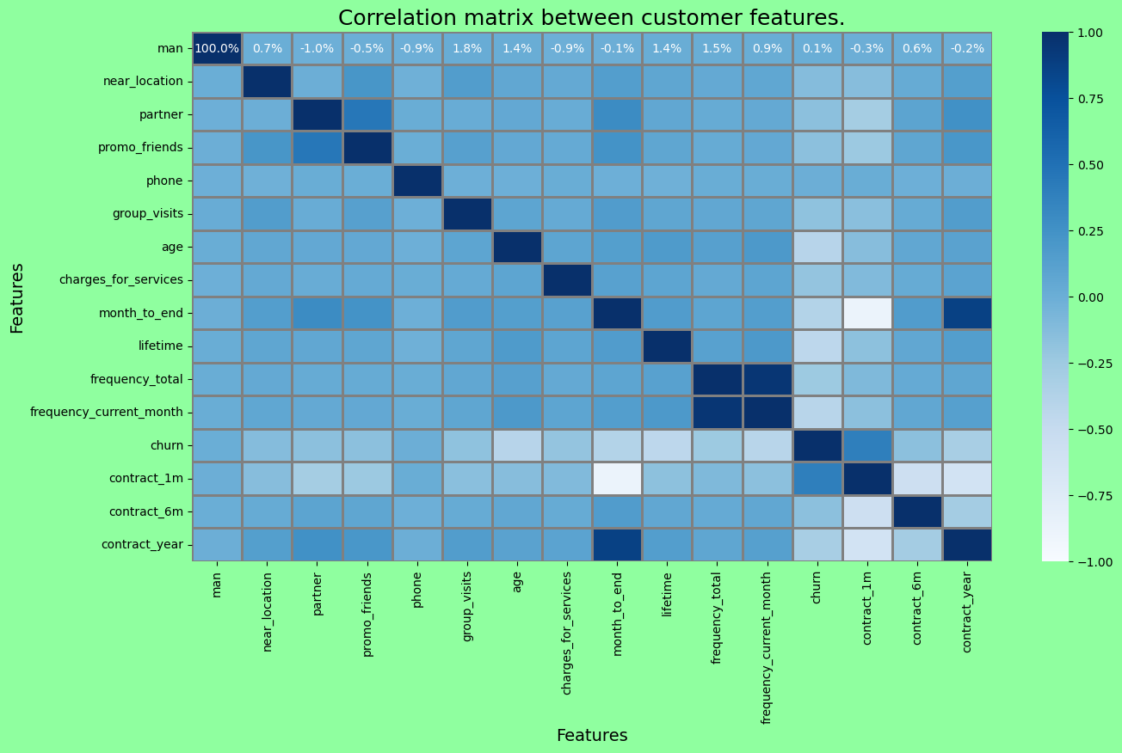
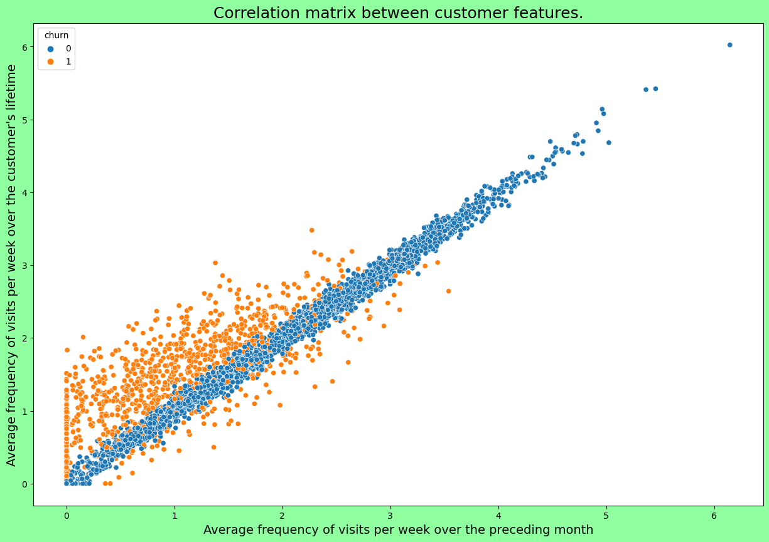
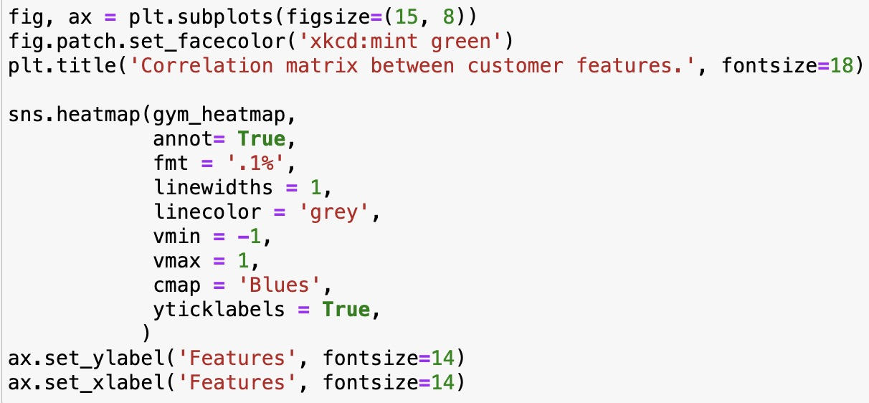
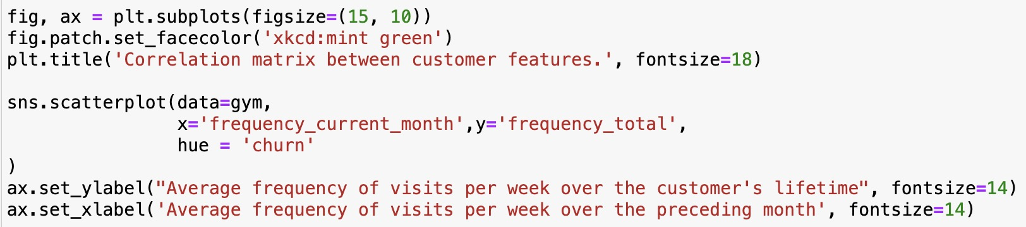
Correlation matrix between customer features
For clients who continue to visit the gym, the frequency of visits does not change.
However, for those who left, the frequency of visits has decreased in the last month, compared to the previous period.
BEFORE
AFTER

Slide 9
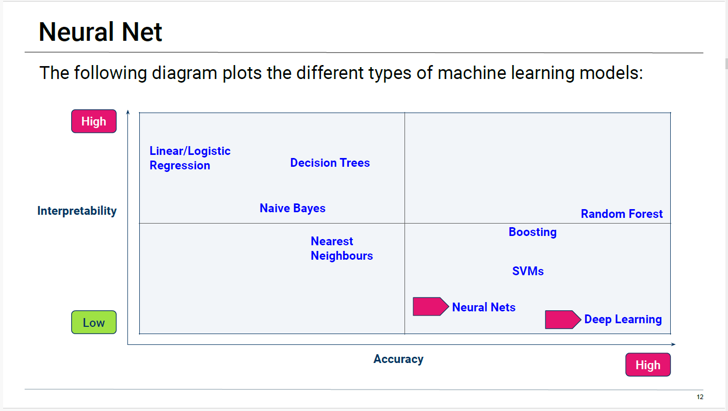
Build a model to predict user churn
Notes:
Note: Extract from Monash Data Boot Camp Lesson 21.1

Slide 10
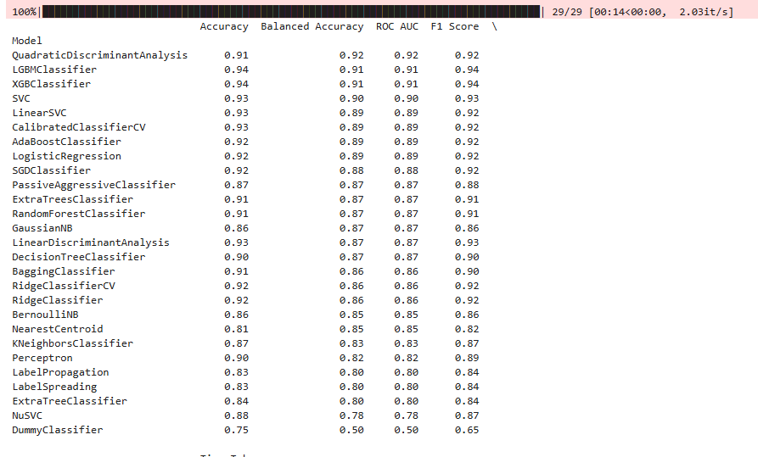
LazyPredict
strong predictive capability across multiple classifiers, particularly favoring the XGBClassifier for its overall performance.
However, the final choice of the model should also consider the specific needs of the application, such as speed and interpretability.

Slide 11
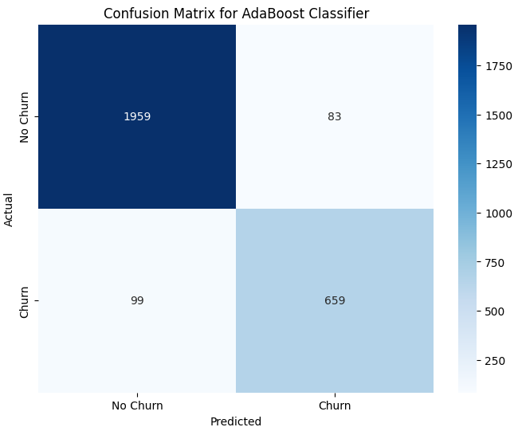
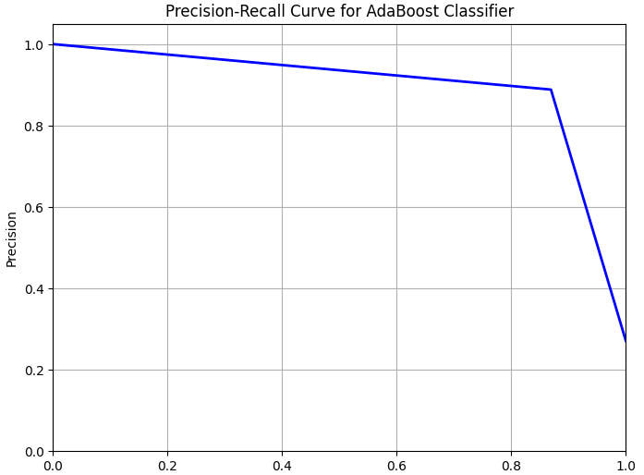
Adaptive boost classifier
Model Strengths: With high precision and recall, AdaBoost classifier is effective at identifying customers likely to churn and is also reliable in minimizing misclassification of loyal customers.
Areas for Improvement: False negatives (missed churners) indicate the model may overlook some customers who are at risk of leaving. Consider additional techniques like hyperparameter tuning, ensemble methods with different configurations, or gathering more features if reducing false negatives is a priority.

Slide 12
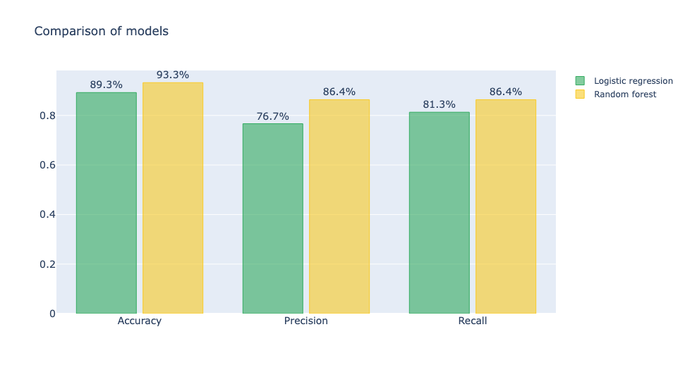
Train dataset with “logistic regression” method
This section demonstrates setting up a logistic regression model for a binary classification problem and using stratified data splitting to handle class imbalance. Stratification helps maintain the original class proportions in both training and test sets, ensuring the model is trained and tested fairly across the classes.

Slide 13
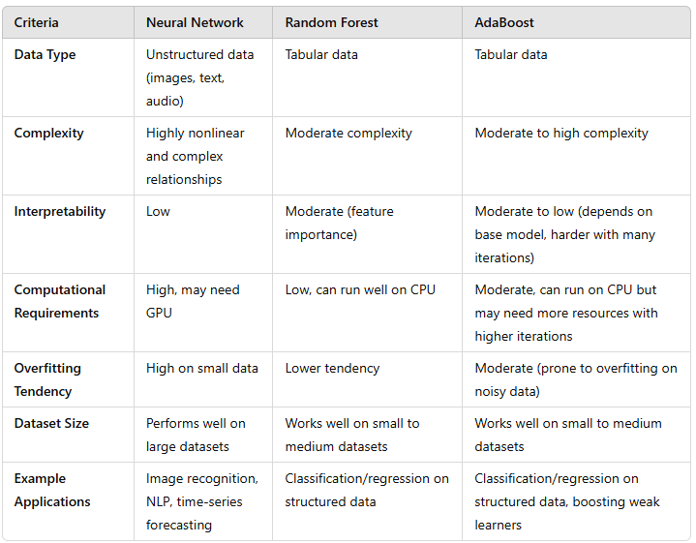
COMPARISONS – WHY RANDOM FOREST?
NEURAL NETWORK: BIG DATA
RANDOM FOREST: FEATURES
ADABOOST: OUTLIERS

Slide 14
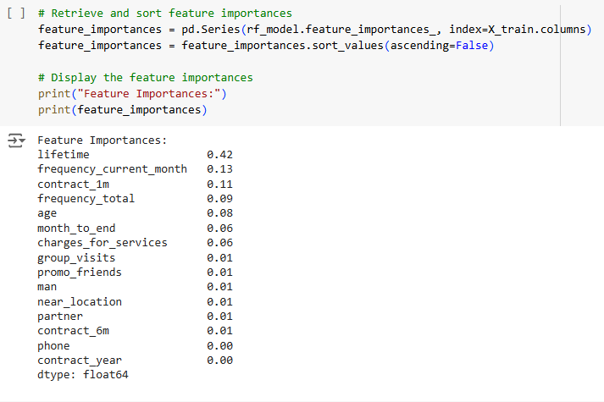
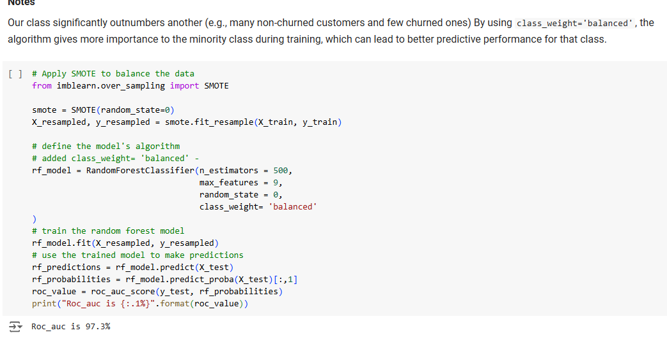
COMPARISONS – BETWEEN OUR MODELS OF CHOICES
SMOTE – BALANCE DATA
FEATURE: LIFETIME, FREQUENCY OF VISIT

Slide 15
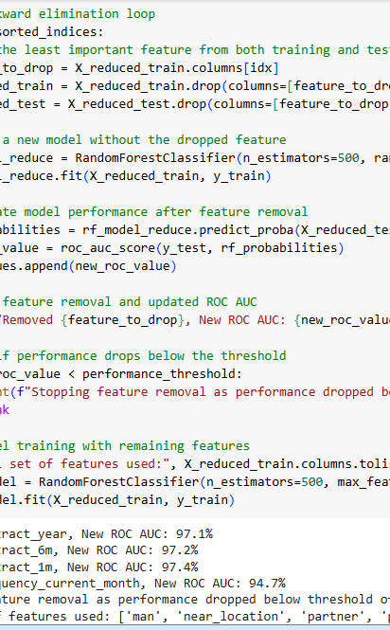
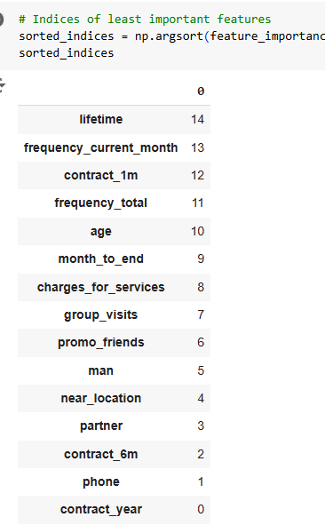
Optimizations and Feature
TEST THE NOISE
REMOVE FACTORS NOT CONTRIBUTING

Slide 16
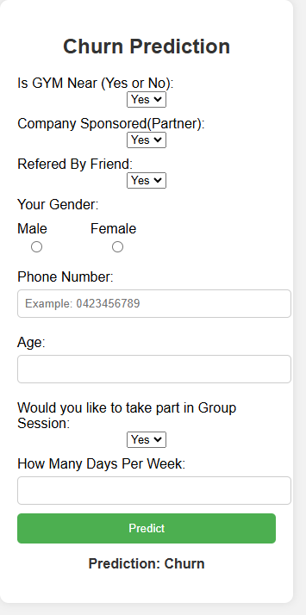

FLASK CHURN PREDICTION

Slide 17
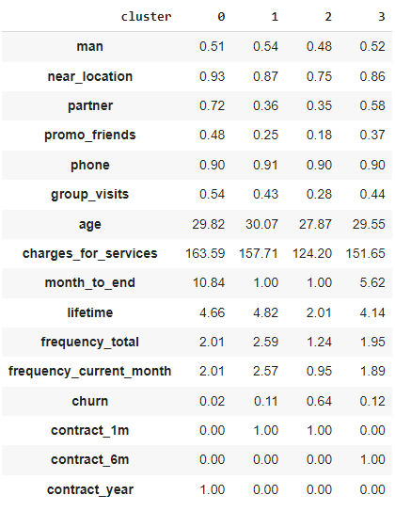
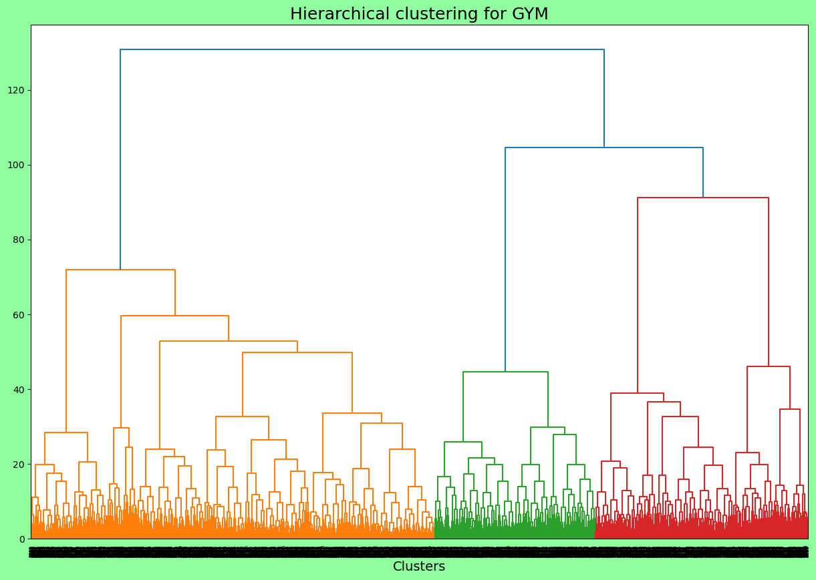
Standardize the data and plot a dendrogram
As we can see from the dendrogram, the system allows us to divide clients into 3 clusters.
However, according to the terms of reference during training, the model based on the K-Means algorithm will be divided into 4 clusters.

Slide 18
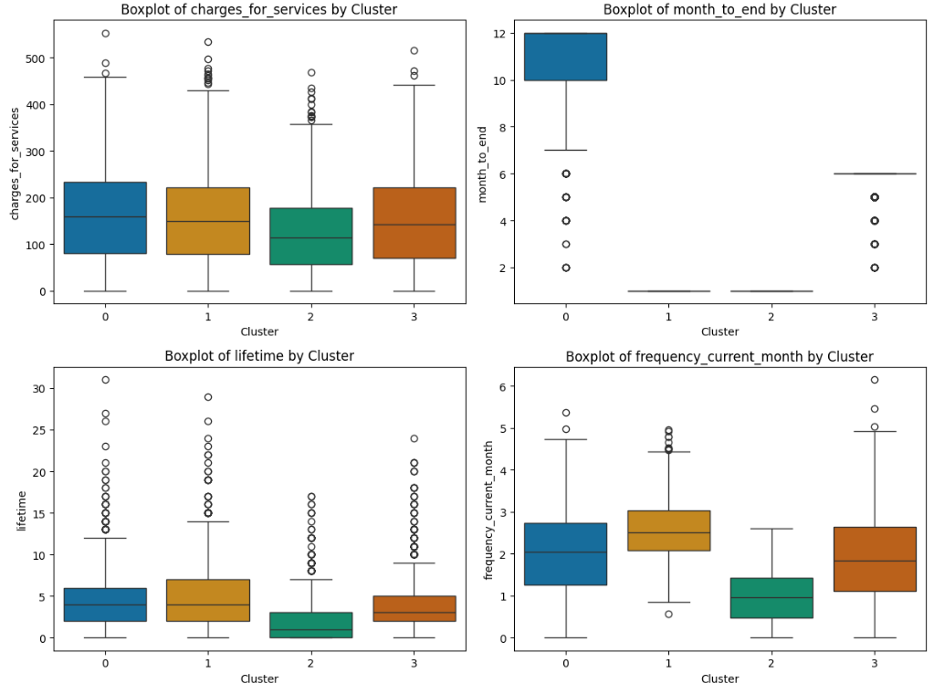
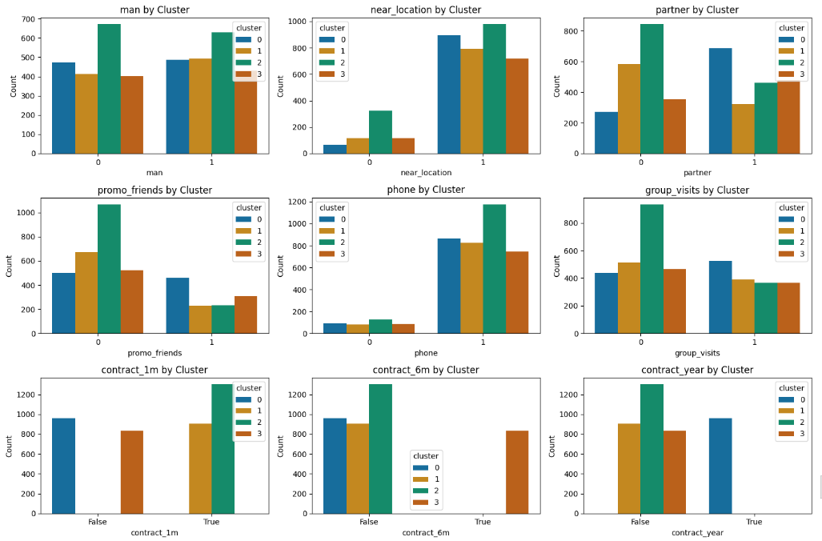
Plot distributions of features for the clusters
The following features have an explicit division into clusters: month_to_end contract_6m contract_year.

Slide 19
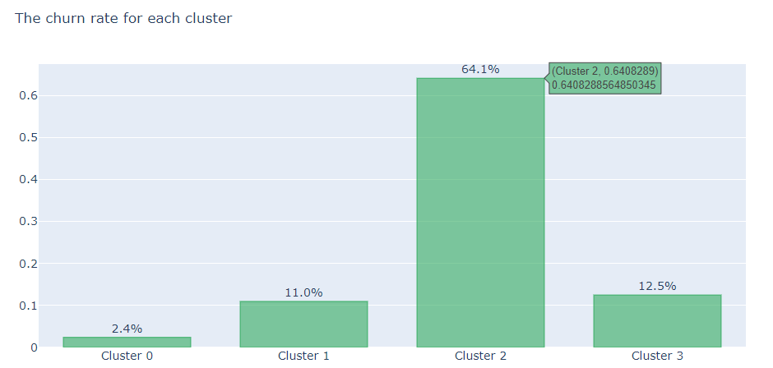
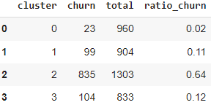
As we can see, clusters vary greatly in terms of churn rate.
Cluster 0 has the lowest churn rate (2.4%). Clients from clusters 1 and 3 are also quite loyal and their churn rate is less 13%. Clients in cluster 2 is more than 60% likely to quit.
Here are the general characteristics of customers who are more likely to churn: most of them have a lifetime below three months, visit less than twice a week, get lower promo_friends, the average additional extra charge below 125 USD, and they still have remaining contract period for about four months.

Slide 20
recommendations
Enhance Engagement: Develop strategies to increase class attendance among all customers, with personalized offerings and incentives for regular attendees.
Targeted Marketing for Age Groups: Tailor marketing efforts to target and attract customers within the age range of 18-25, as they have the highest churn rate. Consider creating specialized programs or offers that cater to their needs and preferences.
Customer Value Enhancement: Focus on extending customer lifetime value by providing tailored services, exclusive benefits, and loyalty programs for long-term members.
Strengthen Referral Programs: Implement initiatives to encourage more churned customers to refer the gym to their friends, leveraging word-of-mouth marketing to boost retention.

